Slide 1
Random Effects models in ANOVA
Kejia Peng
Chen Yang

Slide 2


Think of such a study
Comparison of strength
Gender

Slide 3

Think of such a study
Comparison of strength
Nations

Slide 4
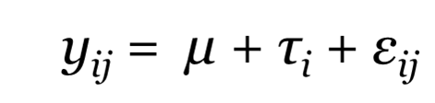

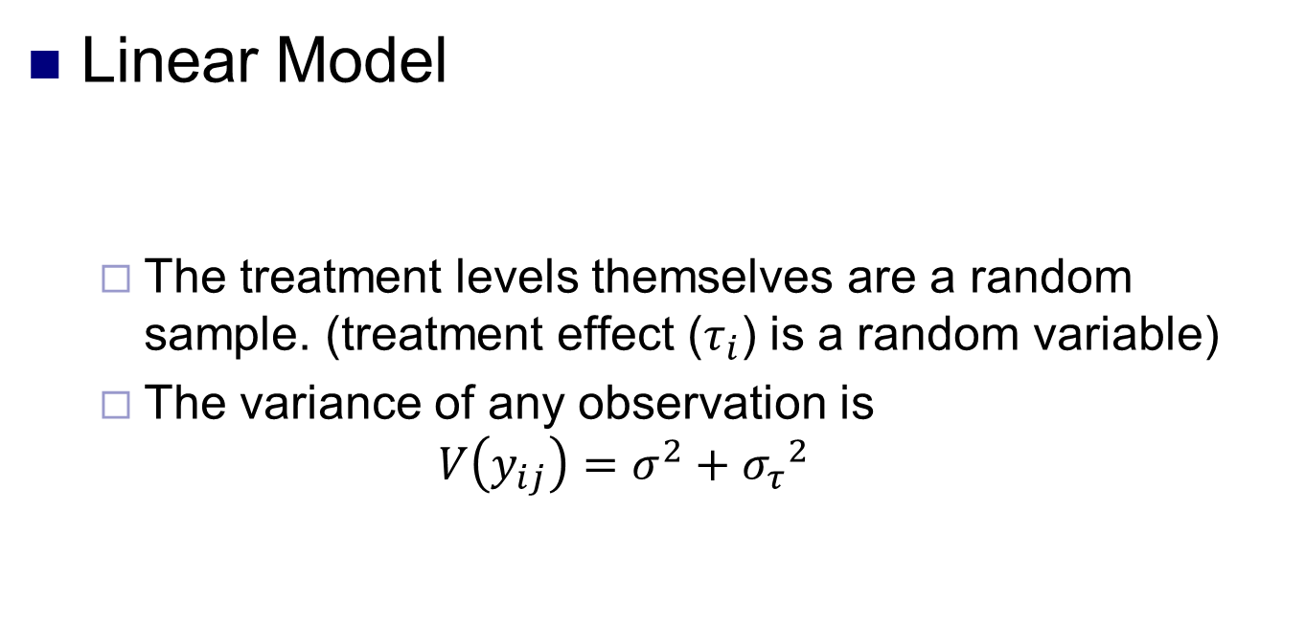
Random-effects Model
Linear Model
The treatment levels themselves are a random sample. (treatment effect ($τ_{i}$) is a random variable)
The variance of any observation is
$$V\left(y_{ij}\right)=σ^{2}+{σ_{τ}}^{2}$$

Slide 5

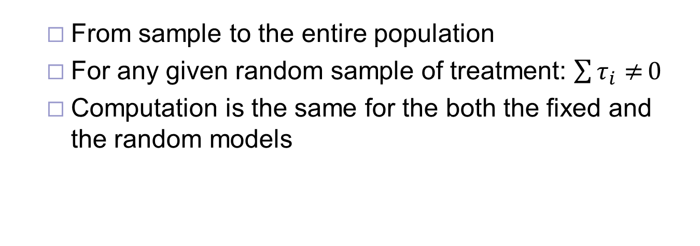
Random-effects Model (Cont’d)
Linear Model
From sample to the entire population
For any given random sample of treatment: $\sum{τ_{i}≠}0$
Computation is the same for the both the fixed and the random models

Slide 6

Differences between fixed and random-effects model
The testing hypothesis
The sampling procedures
Fixed model: the treatment levels are selected purposefully
Random Model: the treatment levels are selected randomly, and the
unknown variance of the population of treatment effects contributes to the total sum of squares

Slide 7


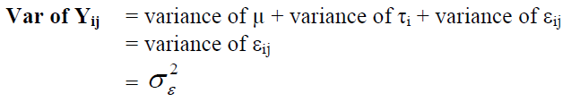


Differences between fixed and random-effects model (cont’d)
The expected sums of the effects
Fixed model:
Random Model:
The expected variances
Fixed model:
Random Model:

Slide 8
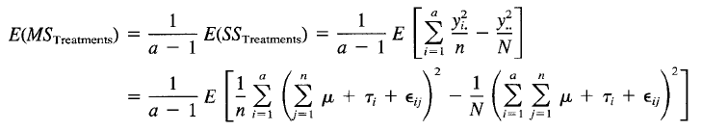



Variance Components

Slide 9
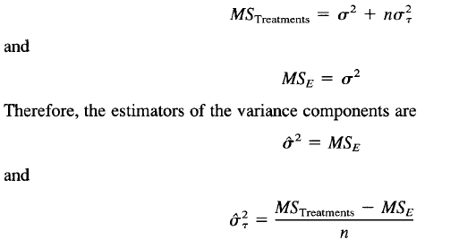
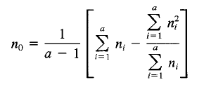
Estimators of the Variance Components
Special Case:

Slide 10
Analysis of Variance (ANOVA)
Example Description:
A textile company weaves a fabric on a large number of looms. It would like the looms to be homogeneous so that it obtains a fabric of uniform strength. The process engineer suspects that, in addition to the usual variation in strength within samples of fabric from the same loom, there may also be significant variations in strength between looms. To investigate this, she selects four looms at random and makes four strength determinations on the fabric manufactured on each loom.

Slide 11
Analysis of Variance (ANOVA)
Data

Slide 12
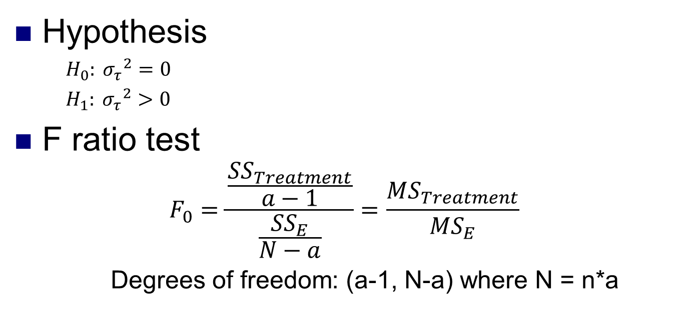
Analysis of Variance (ANOVA)
Hypothesis
$H_{0}: {σ_{τ}}^{2}=0$
$H_{1}: {σ_{τ}}^{2}>0$
F ratio test
$$F_{0}=\frac{\frac{{SS}_{Treatment}}{a−1}}{\frac{{SS}_{E}}{N−a}}=\frac{{MS}_{Treatment}}{{MS}_{E}}$$
Degrees of freedom: (a-1, N-a) where N = n*a

Slide 13

Analysis of Variance (ANOVA)
$${SS}_{Treatment}=\sum_{i=1}^{a}{\frac{{y_{i.}}_{}^{2}}{n}}−\frac{{y_{..}}^{2}}{N}$$
$${SS}_{E}=\sum_{i=1}^{a}{\sum_{j=1}^{n}{{{(y}_{ij}−\overline{y_{i}}.)}^{2}}}$$
$${MS}_{E}=\frac{{SS}_{E}}{N−a}$$
$${MS}_{Treatment}=\frac{{SS}_{Treatment}}{a−1}$$

Slide 14
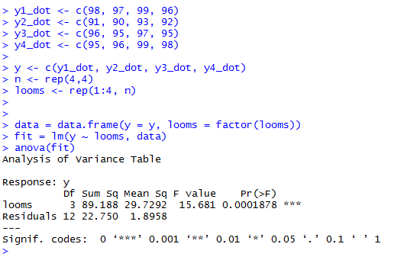
Analysis of Variance (ANOVA)
R code

Slide 15
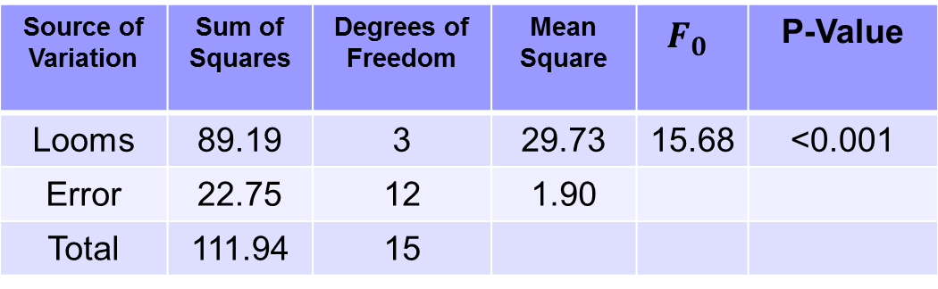
Analysis of Variance (ANOVA)
Result
Source of Variation | Sum of Squares | Degrees of Freedom | Mean Square |  | P-Value
Looms | 89.19 | 3 | 29.73 | 15.68 | <0.001
Error | 22.75 | 12 | 1.90
Total | 111.94 | 15

Slide 16
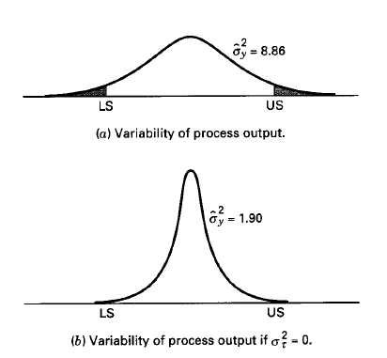
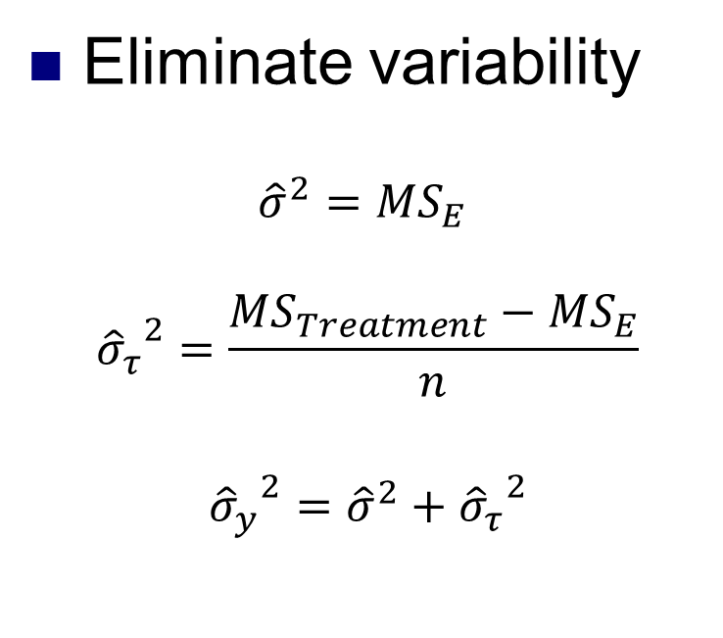
Analysis of Variance (ANOVA)
Eliminate variability
$${\hat{σ}}^{2}={MS}_{E}$$
$${{\hat{σ}}_{τ}}^{2}=\frac{{MS}_{Treatment}−{MS}_{E}}{n}$$
$${{\hat{σ}}_{y}}^{2}={\hat{σ}}^{2}+{{\hat{σ}}_{τ}}^{2}$$

Slide 17


Confidence Interval
Confidence Interval for the Variance Component is hard to get
Confidence Interval on the Ratio

Slide 18




Confidence Interval (Cont’d)
Where
A 100 (1- ) percent confidence interval for is:

Slide 19
Other types
Two-factor factorial with random factors
Two-factor mixed model

Slide 20
Reference
http://www.plantsciences.ucdavis.edu/agr205/Lectures/2011_Lectures/L10_MixModels.pdf
Douglas C. Montgomery, Design and Analysis of Experiments, 5th Edition, June 30, 2000

Slide 21
Thank You!

